Slide 1
CAR RESALE VALUE PRICE PREDICTION USING COMPILER DESIGN
​
S. Md Jaffer – 192211684
Abdul Haseeb – 192211497
G.K Ranjith -192221120

Slide 2


Agenda
ABSTRACT
INTRODUCTION
KEY FACTORS INFLUENCE
PROPOSED DESIGN
FUNCTIONALITY
UI DESIGN
CONCLUSION

Slide 3
ABSTRACT
The prediction of car resale values is a critical aspect for stakeholders in the automotive industry, including manufacturers, dealers, and consumers.
Accurate resale value predictions can influence purchasing decisions, inventory management, and pricing strategies.
This research explores an innovative approach to predicting car resale values using principles from compiler design, a domain traditionally associated with computer programming languages.
Compiler design concepts such as lexical analysis, syntax analysis, semantic analysis, and optimization are leveraged to enhance data preprocessing, feature extraction, and model optimization processes.

Slide 4
Introduction
The automotive market is highly dynamic, with car resale values playing a crucial role in the economic decisions of buyers, sellers, and dealers. Accurate prediction of these resale values can significantly impact pricing strategies, inventory management, and consumer satisfaction.
Compiler design principles enhance the data processing pipeline, ensuring structured and efficient handling of diverse data sources. This approach improves model interpretability and efficiency, facilitating the identification of relevant features.
Our research aims to contribute valuable insights to stakeholders in the automotive industry, guiding future research in this interdisciplinary domain.

Slide 5
KEY FACTORS INFLUENCE
Age and mileage of the car
Brand and model reputation
Maintenance history and condition
Market trends and economic factors
Geographical location and seasonal effects

Slide 6
PROPOSED DESIGN
Lexical Analysis (Data Preprocessing)
Data Cleaning: Correct or remove erroneous entries and handle missing values.
Data Normalization: Standardize scaling for numerical features and encode categorical variables.
Tokenization: Break down car descriptions into individual attributes (e.g., make, model, year).
Syntax Analysis (Data Structuring)
Structure Validation: Ensure logical structure and adherence to predefined formats.
Hierarchical Structuring: Organize data into hierarchical structures to reflect attribute relationships.

Slide 7
PROPOSED DESIGN
Semantic Analysis (Feature Extraction)
Feature Selection: Identify and select relevant features using statistical analysis and domain knowledge.
Feature Engineering: Create new features (e.g., car age, depreciation rate) and ensure consistency.
Optimization (Model Development and Tuning)
Model Selection and Tuning: Choose and fine-tune machine learning models (e.g., regression, decision trees).
Model Evaluation: Assess performance using MAE, RMSE, and cross-validation.
Performance Optimization: Implement ensemble methods, feature selection, and dimensionality reduction for enhanced performance.

Slide 8
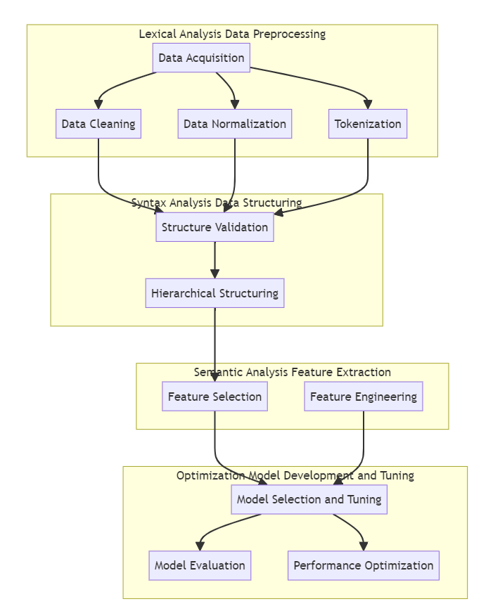
PROPOSED DESIGN

Slide 9
FUNCTIONALITY
Data Processing and Analysis:
Cleanse and tokenize raw data.
Validate data integrity and consistency.
Extract meaningful features like car age, mileage, and market demand.
Feature Engineering:
Generate new features from existing data.
Standardize numerical features.
Encode categorical variables for machine learning.
Model Development:
Choose suitable machine learning algorithms.
Apply optimization techniques for model performance.
Optimize hyperparameters for accuracy and generalization.
Integration, Deployment, and User Interface:
Integrate preprocessing, feature extraction, and model training.
Deploy for real-time or batch prediction.
Provide a user-friendly interface with interactive dashboards and customizable reports.

Slide 10
UI DESIGN
Layout Design:
Dashboard: Centralized overview of metrics.
Prediction Form: Input car specs.
Prediction Results: Display predictions.
Visualization Tools: Graphical representations.
User Profile: Manage settings.
Feasible Elements Used:
Input Fields: Text, dropdowns, sliders.
Buttons: Submit, clear/reset.
Data Visualization Widgets: Charts, tables.
Navigation Menu: Easy access to sections.
Feedback Mechanisms: User input for improvement.
Additional Considerations:
Responsive Design: Fits all screen sizes.
Accessibility: Complies with guidelines.
User Testing: Gather feedback.
Iterative Design: Continuous improvement.

Slide 11
CONCLUSION
Compiler design implementation has notably boosted the precision of car resale value predictions. Through sophisticated algorithms and optimization techniques, compilers efficiently process vast datasets, resulting in more reliable estimations.
Compiler-designed prediction models have demonstrated improved computational efficiency and reduced processing time.
This efficiency is essential for generating timely predictions in dynamic market conditions, facilitating better decision-making for buyers and sellers alike.

Slide 12
THANK YOU

